Slide 1
Solving & Preventing Dimensional Accuracy Issues For the LPBF Process
Ryan Aday
07/25/2024 Divergence 3D Presentation

Slide 2

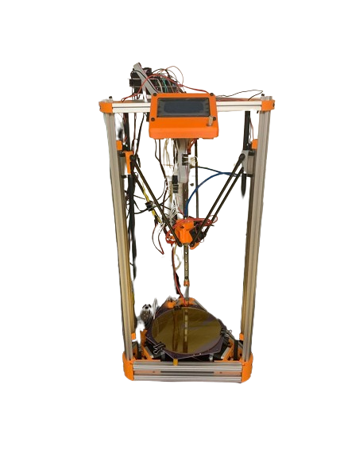
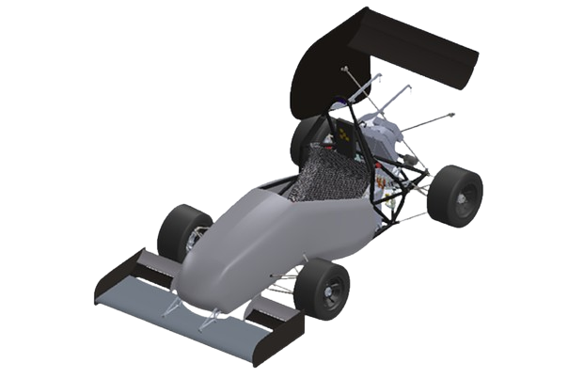
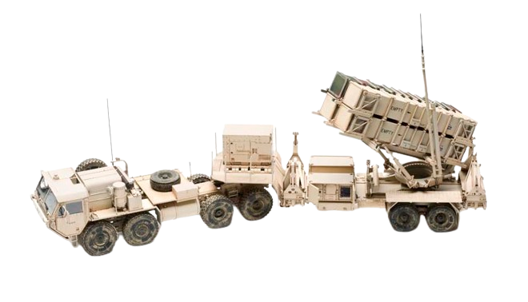
Let’s get right into it…
MSME from Georgia Tech
Incoming MSEE from UC Boulder
PE, LSSBB
Designed & built 3D printers since middle school (FFF, SLA)
Raytheon
Hands-on hardware, software, firmware fixes for Patriot
Head/maintainer of FFF, SLS printers for prototype parts
Motor, servo controller experience w/ HyTech Racing

Slide 3
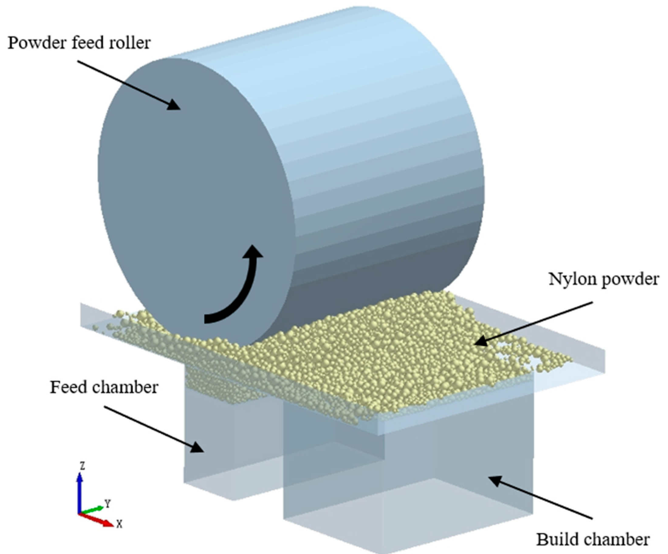
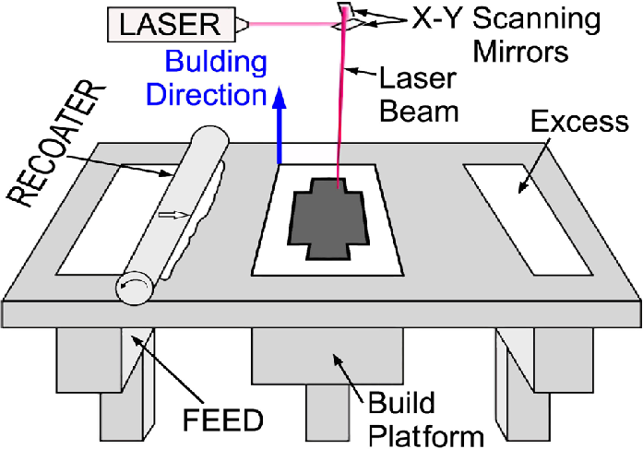
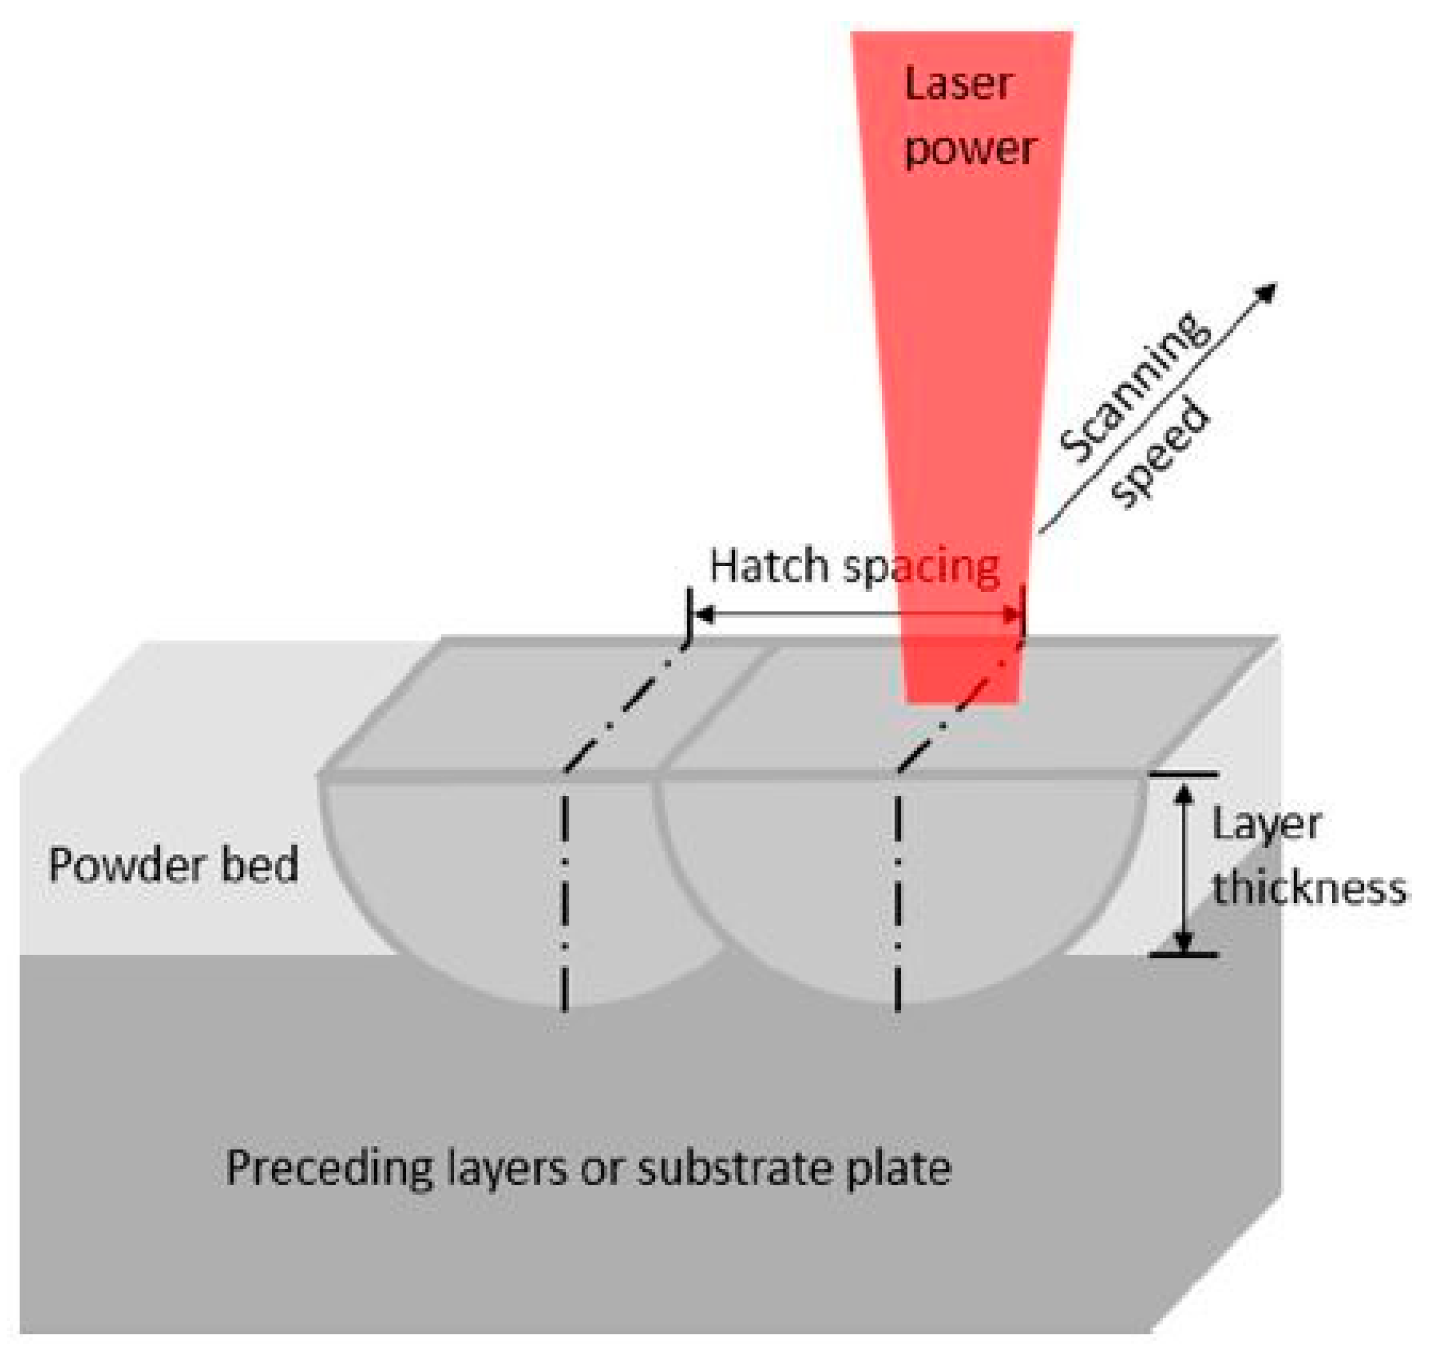
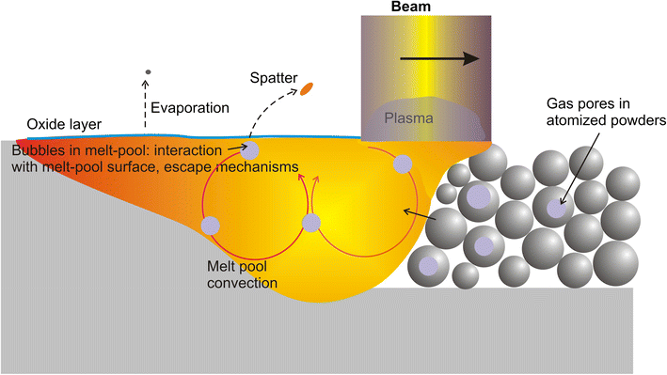
LBPF Overview
Powder Deposition
Lasing
Solidification
Platform Realignment

Slide 4
Dimensional Accuracy Issues
Material
Thermal Stress & Distortion
User-Based
Machine Calibration & Maintenance
Environmental Conditions
Design-Based
Powder Material Inconsistencies
Post-Processing Techniques
Support Structure Implementation
Laser Power Fluctuations
Build Plate Adhesion
Slicer Settings
Software, Firmware, Hardware (SFH) Limitations

Slide 5

User-Based Issues
Machine Calibration & Maintenance
Issue: Servos, gyro, roller loses accurate movement/placement due to wear
Causes: Layer shifts, surface roughness -> inaccuracies in the final dimensions
Environmental Conditions
Issue: Temperature, humidity, variations within the build chamber
Causes: Oxidation of the powder -> inconsistent melting
Post-Processing Techniques
Issue: Machining, stress-relieving, heat treatments induces additional stresses/removes material unevenly
Causes: Deviations from the desired dimensions and geometrical tolerances
Pre-Slice Techniques
Issue: The provided part slice/files are not properly resized to account for shrinkage
Causes: Undersized parts

Slide 6
Material Issues
Thermal Stress & Distortion
Issue: Uneven cooling rates after lasing
Causes: Cracking, warpage
Powder Material Inconsistencies
Causes: Variable melting behavior, voids
Build Plate Adhesion
Issue: Disadhesion between first layer & build plate
Causes: Layer shifts -> misalignment of subsequent layers
Issue: Variations in powder particle size, shape, and distribution affect packing density, deposition

Slide 7
Design-Based Issues
Laser Power Fluctuations
Issue: Inconsistent laser power
Support Structure Implementation
Issue: Inadequate or excessive support structures
Slicer Settings
Issue: Non-ideal settings for chosen scan pattern, layer thickness, and laser speed
Causes: Residual stresses, anisotropic properties, and dimensional distortions
SFH Limitations
Causes: Uneven/inconsistent melting and solidification, increased solubility
Causes: Heat dissipation and/or part stability
Causes: Slicer resolution, beam diameter larger than required, servos inadequate for scan speeds, etc.
Issues: Fundamental with the design of the printer

Slide 8
Root Cause Analysis Checklist
Immediate Checks (User-Based)
1. Were the scheduled maintenance/calibration intervals followed? (Gyros, bed-leveling, laser, servos, roller, powder depositor)
2. Was the print bed within permissible humidity & temperature range?
3. What post-processing techniques were used? (Machining, coating, heat treatments to spec)
4. Was the part sized properly to account for material shrinkage?
Deeper Dive (Material)
1. Are there any observed cracks in the print?
If yes, likely to be thermal stresses/distortion during cooling
2. Are voids present?
If yes, powder dimensionality or characteristics or lasing power out of spec
3. Observed layer lines?
If yes, poor bed adhesion.
Inherent Design Flaws/Stipulations
1. Is the laser emitting consistent power?
2. What, if any, support structures were used?
3. What were the slicer settings used to prepare the print?
And as a side note, are these the proper settings for the material/was the user modifying settings within acceptable ranges?
4. Surface artifacts? (scaling, pixelated surface, etc)
If yes, SFH issue possible.

Slide 9
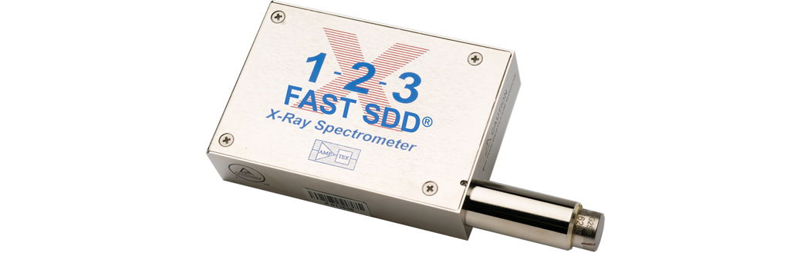
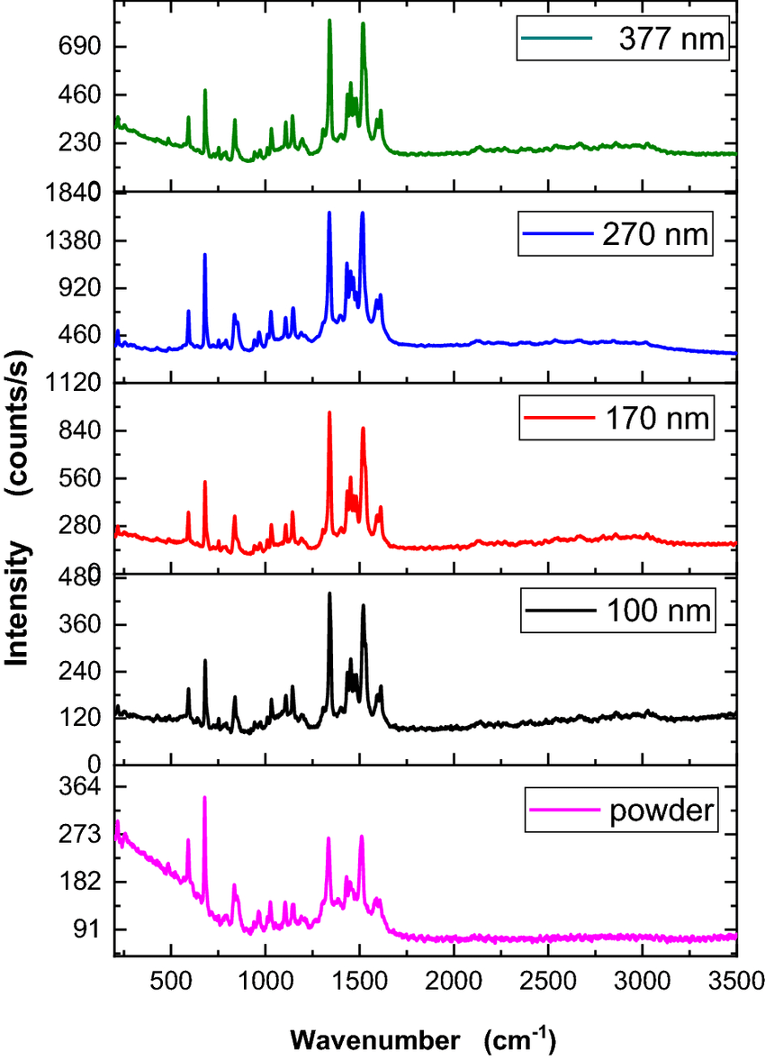
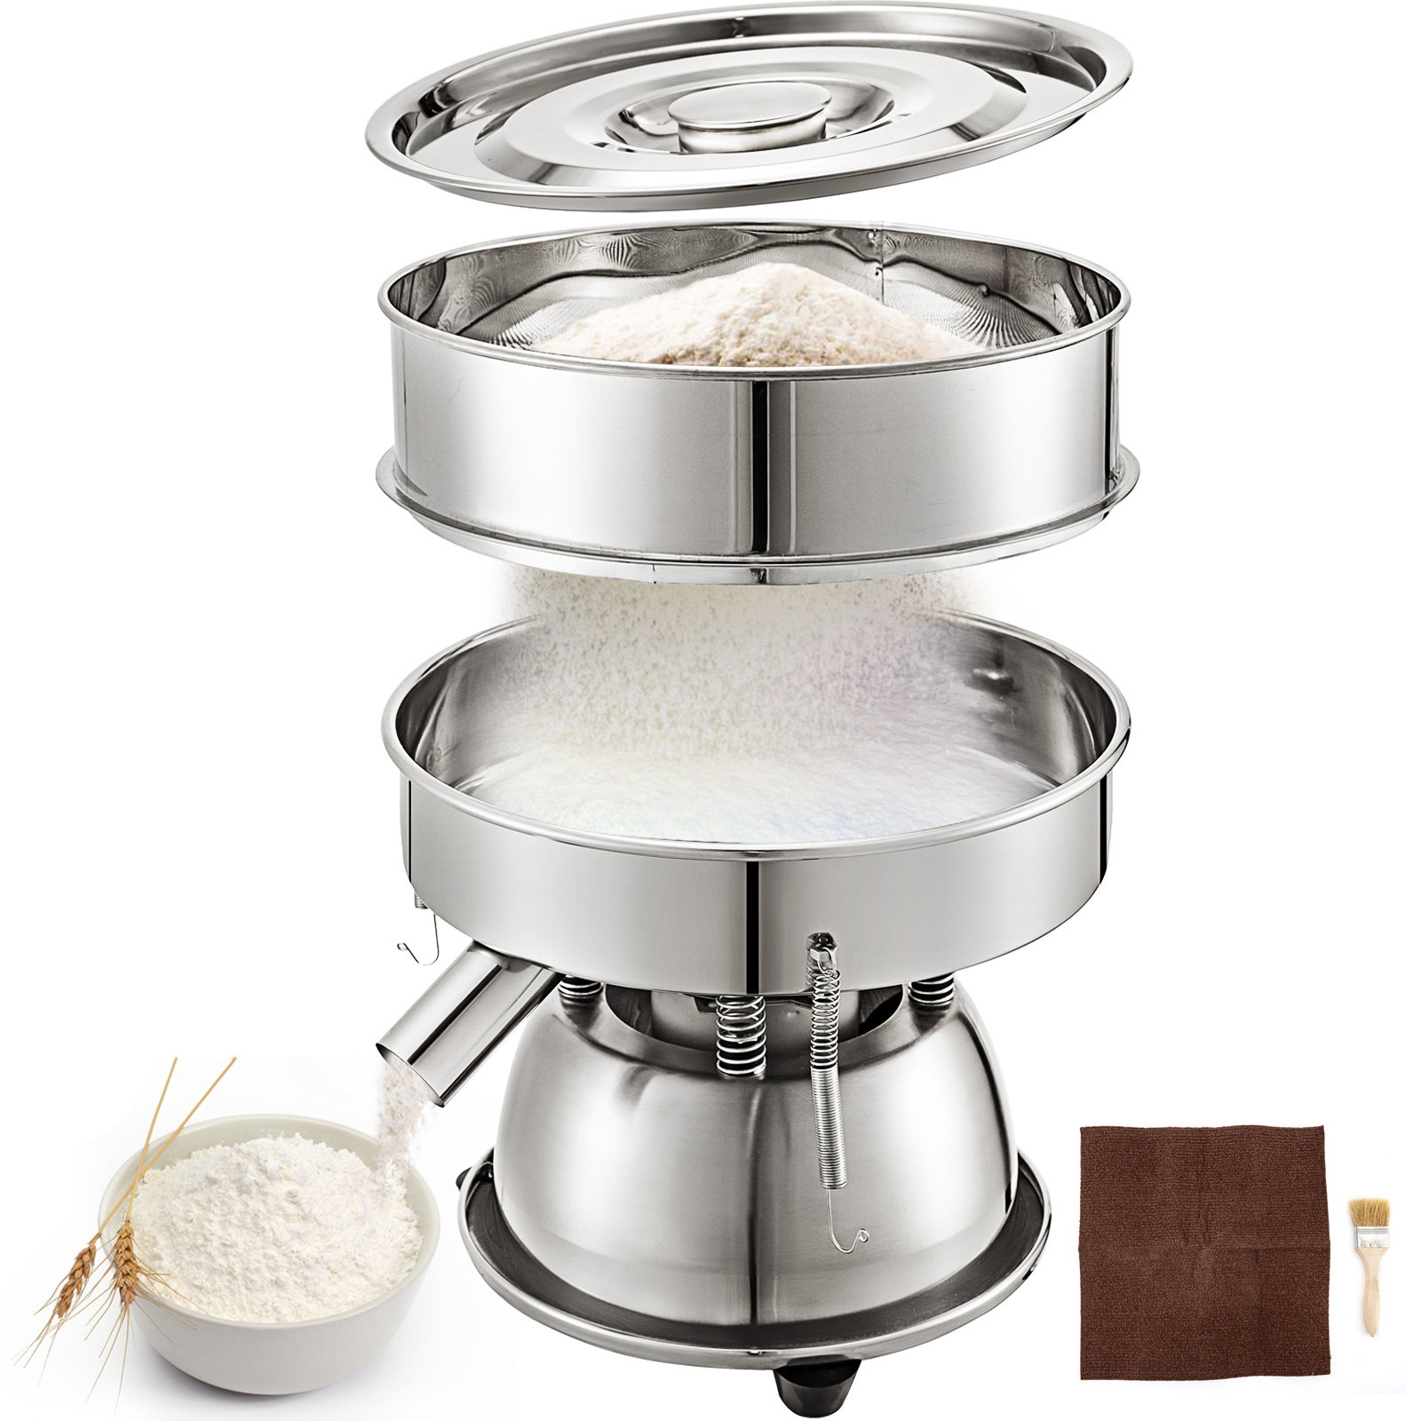
More Permanent Solutions
Eliminate variability from the user side
Ensure powder consistency
Sieve for dimensionality
Vevor Sieve
Can also check post-production using OpenCV to determine dimensional consistency for a sample
X-ray Spectroscopy to determine powder purity & correct alloy mixture for redundancy
Cheap sensor may be used to check before prints
https://www.amptek.com/internal-products/x-123-complete-x-ray-spectrometer

Slide 10


More Permanent Solutions (cont.)
Built-in maintenance scheduler & provided checklist
Both for slicing & setting up the printer
Auto-calibration before prints
Environmental & sensor data logger
Temperature, humidity sensors to collect the past 1000 seconds and determine the moving average & variability
Inkbird Hygrometer & Thermometer
Voltage sensor for laser to determine energy output stability
https://store.egauge.net/High-Voltage-Sensor

Slide 11
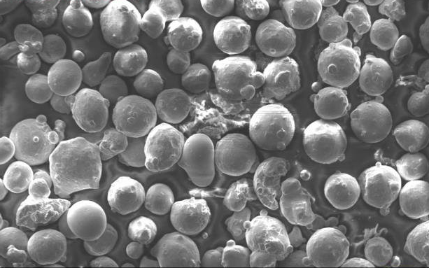
More Permanent Solutions (cont.)
Continuous print checks
OpenCV to identify cracks, voids, layer shifts, etc. during & after print
If defect identified, stop print and issue recommendation
Develop optimized parameters for materials
You need to optimize parameters to ensure print speed is as fast as possible while ensuring tolerances are in spec
Feed rate
Lasing power
Hatch spacing
Inherent powder dimensions and tolerances
If applicable, isolate scan strategies, support structures permissible for material

Slide 12
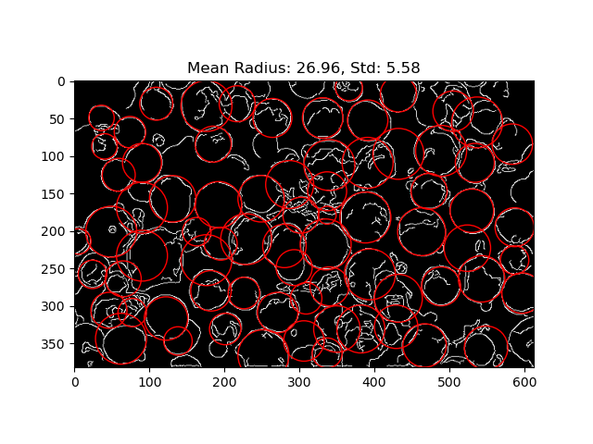
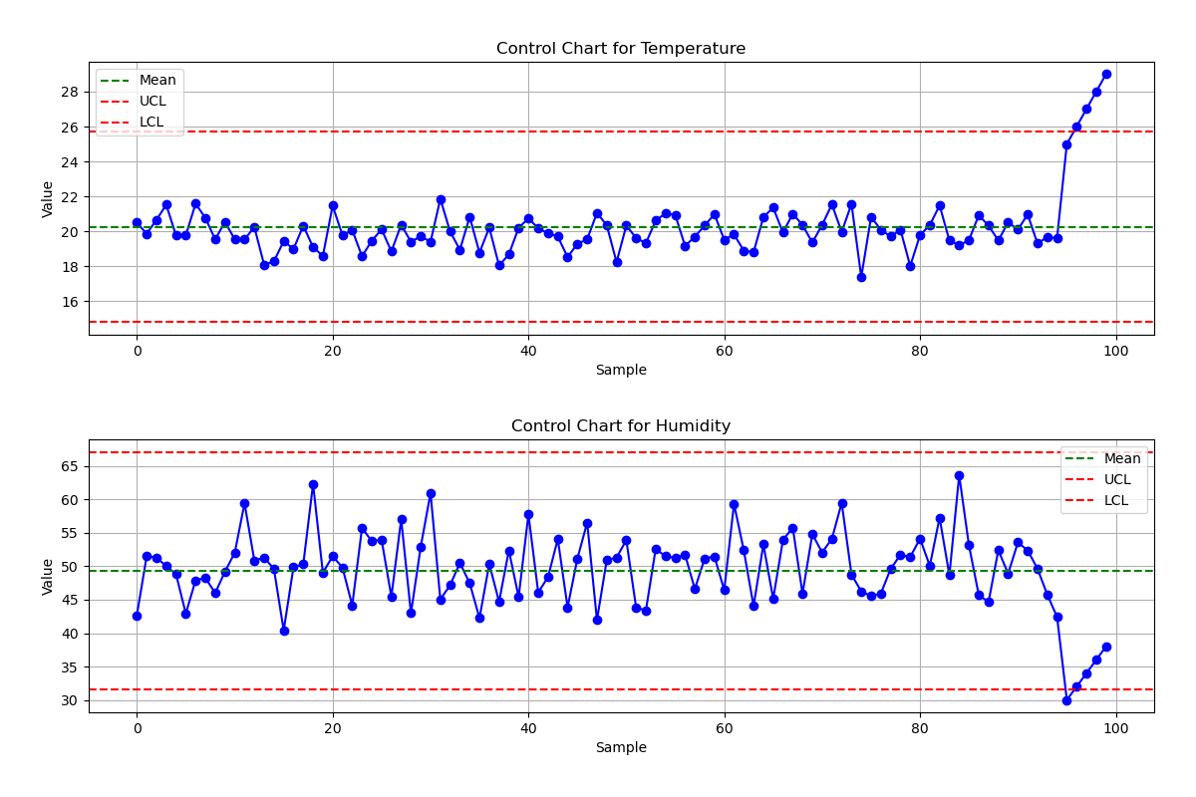
Implementation
My code:
Process control
Powder dimensionality
Parameter optimizer
You can find my work here: https://github.com/ryan-aday/LBPF_Process_Optimizers

Slide 13

Questions?

Slide 14
How the Code Works: process_control.py
Takes any CSV or JSON file format
Assumes each column is a process parameter
For each column, computes the mean & standard deviation
UCL and LCL is the mean +/- 3*std
Plots data points per column, with UCL & LCL
If any points deviate from the UCL/LCL, process is out of control
Suggests new targets based on the current mean

Slide 15
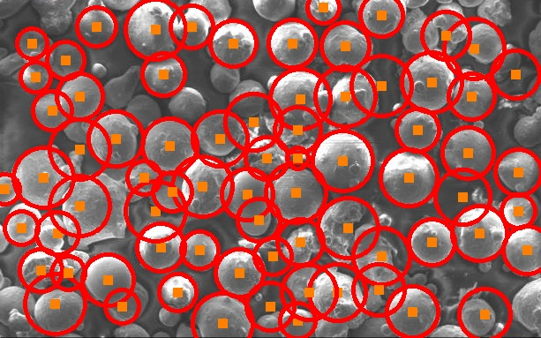
How the Code Works: powder_hough.py
Uses OpenCV packages (also available in C++)
Binarizes image for easier edge detection
Gaussian blur to reduce noise
Canny edge detection to develop clearer distinction between edges
Hough Transforms to determine likelihood of circular features
Minimum center distance, min & max radii, degree of probability, edge detection threshold (p1), accumulator threshold (p2)
Plots the recognized Hough circles atop provided image
May need to be tuned for larger images
Fixed tunes if image capture standardized

Slide 16
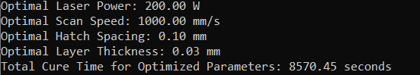
How the Code Works: param_opt.py
Uses:
scipy minimization techniques
Various material properties
Assumptions & Constraints:
Constant laser beam diameter
Targeted normalized enthalpy, solubility, shrinkage
Optimizes for minimum time to cool
Outputs the optimal laser power, scan speed, hatch spacing, layer thickness
Future improvements: characterize and constrain forces occurring during melt
Research Link

Slide 17
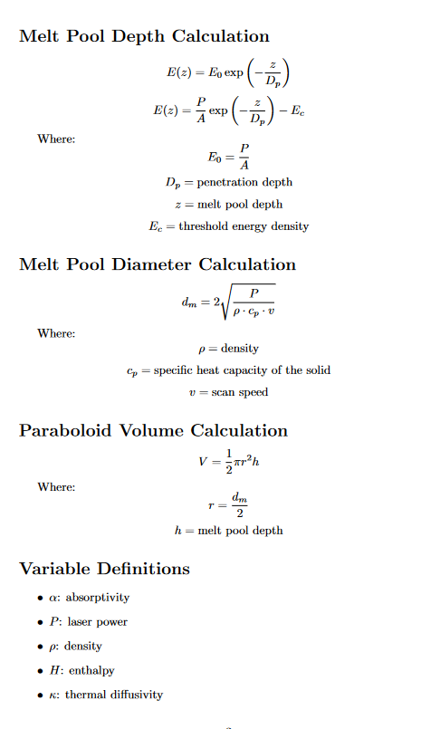
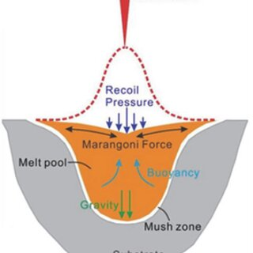
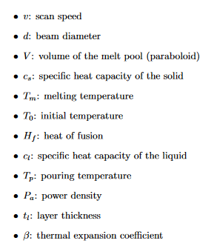
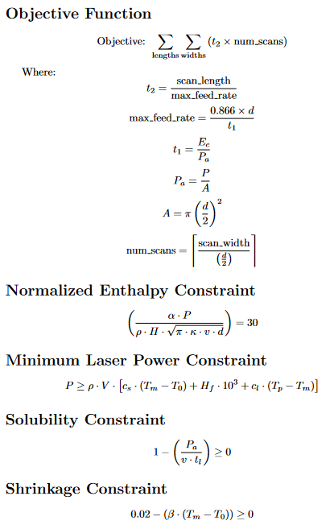
How the Code Works: param_opt.py Equations
Note: Uses references found in the repository.

